Slide 1
Logistic Regression with Stocks
Brian Bruxvoort

Slide 2
Introduction
Basics of Logistic Regression
Logistic Regression in Finance
Basic Example
Complex Example
Other Logistic Regression Techniques
Big Picture/Conclusion

Slide 3
Logistic Regression: The Basics
Similar to linear regression but the predictor variable is binary or categorical
Output is a value between 0 and 1; a percentage
Logistic regression calculates the odds of the outcome as a function of the input variables
Odds = Probability of event occurring / Probability of event not occurring

Slide 4
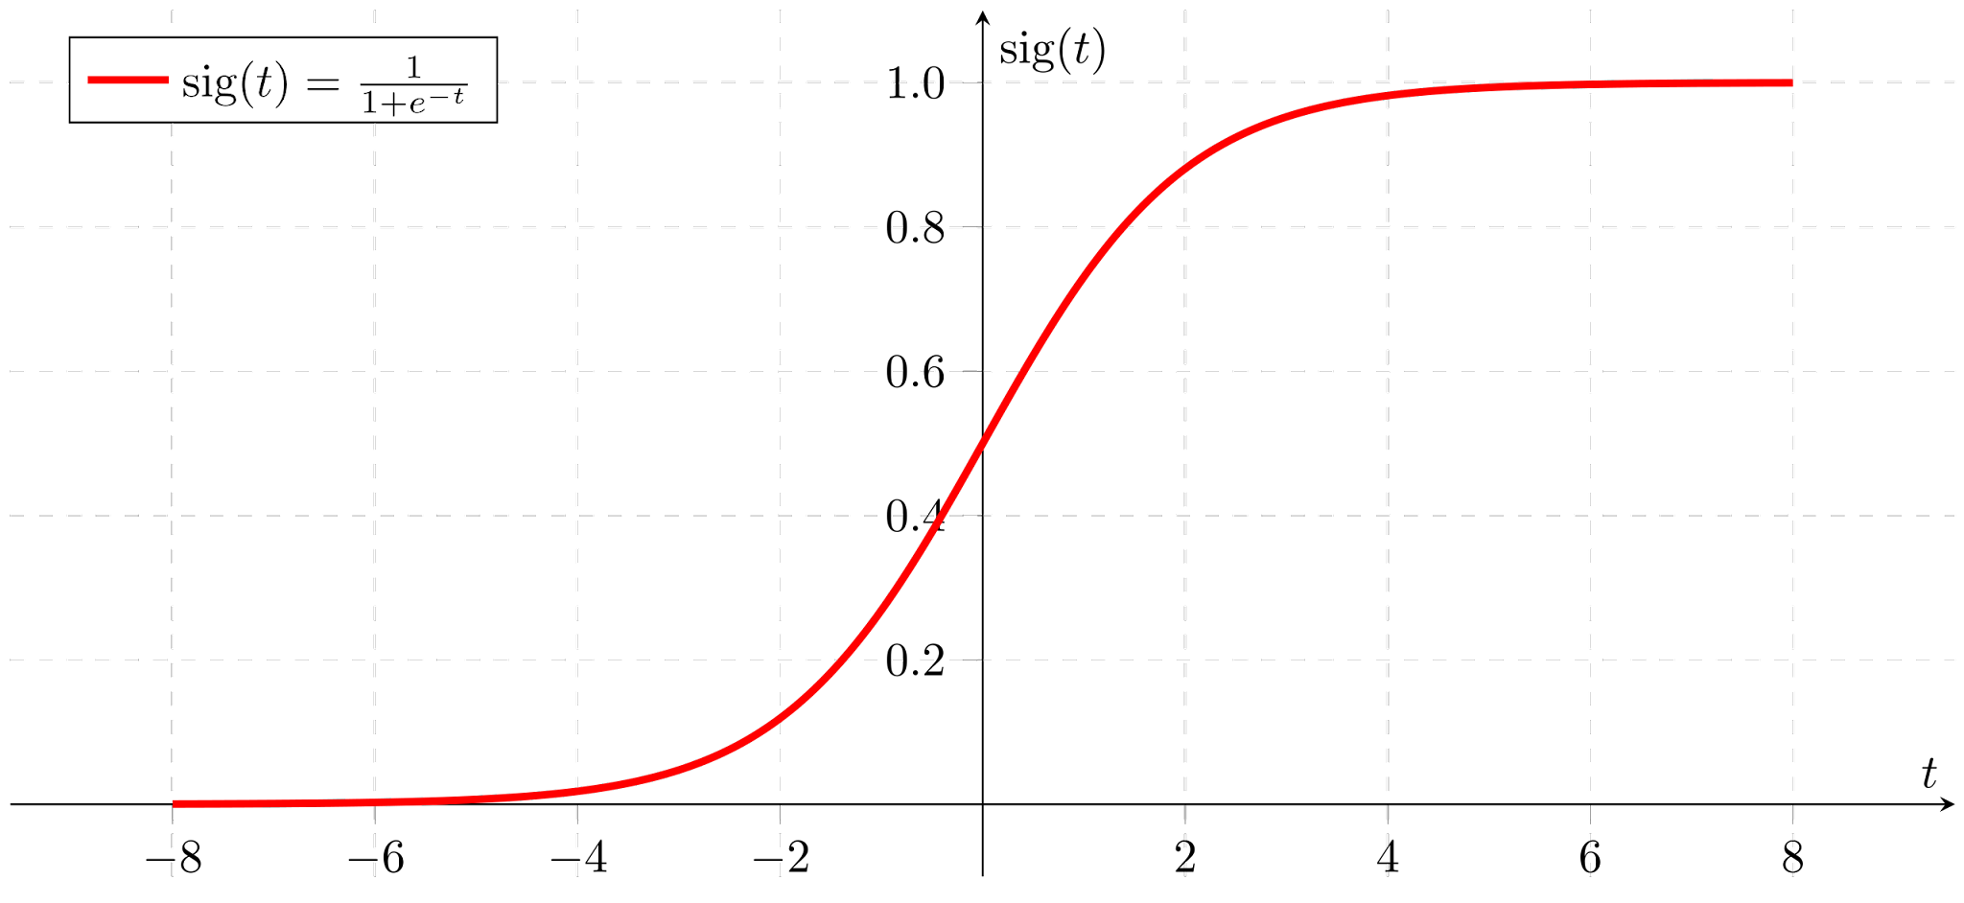
Sigmoid Function/Curve

Slide 5
Logistic Regression in Finance
Helps in making informed stock buying or selling decisions based on the probability of stock price increase or decrease
Helps mitigate financial risks in volatile markets
Other areas such as credit risk analysis and predicting loan default

Slide 6
Basic Example

Slide 7
Financial Model Example

Slide 8
Other Logistic Regression Techniques in R
Glm - very versatile and can handle binary, multinomial, and ordinal logistic regression depending on the family and link function specified
Multinom - response variable includes three or more categories
Vgam - useful for more complex scenarios where you might want non-standard link functions or to include non-linear effects of predictors.
Polr - useful when the categories have a natural ordering.
StepAIC - stepwise selection to find best logistic regression model

Slide 9
Big Picture/Conclusion
Find trends in data using logistic regression
Basics of logistic regression
Value in data-driven decision-making in finance
Multiple techniques can be used

Slide 10
Questions

